Slide 1
WIRELESS
VIDEO DATA
COMMUNICATION

Slide 2
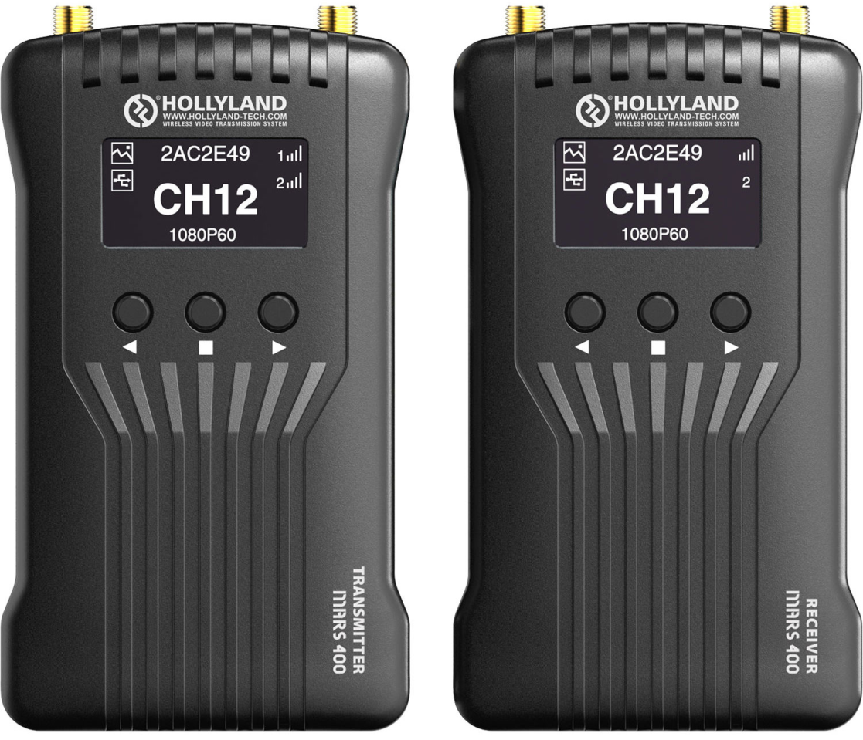
MARS 400 AND 400S
Most wireless transmission systems on the market right now support up to 1080p60 input and transmission, and many support HDR workflows, which will suit your visual needs and the requirements
of most portable monitors.
Figure 1: Hollyland Mars 400 Dual HDMI
Wireless Video Transmission System
https://www.bhphotovideo.com/c/product/1507628-REG/hollyland_mars_400s_mars_400s_sdi_hdmi_wireless.html

Slide 3
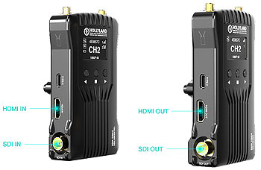
Many professional transmitters have the capability to transmit to multiple receivers simultaneously, such as the Mars 400/400S transmitter that supports transmission to up to two receivers.
Figure 2:HDMI Wireless Video Transmission System
The Mars 400 transmitter features HDMI input up to 1080p60, and the receiver has two HDMI outputs for monitors, computers, or switches.
https://www.bhphotovideo.com/c/product/1507628-REG/hollyland_mars_400s_mars_400s_sdi_hdmi_wireless.html

Slide 4
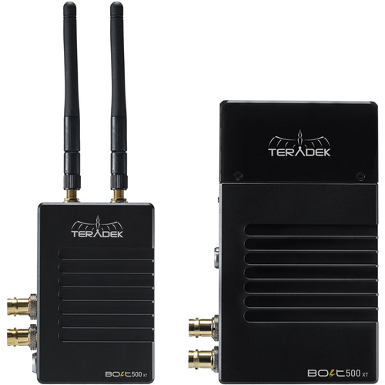
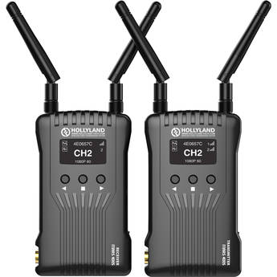
COMPARING DIFFERENT
TECHNOLOGY
TERADEK BOLT 500 XT
MARS 400S
Key Features
Supports up to 1080p60 Resolution
Backward Compatible with Select Systems
3G-SDI and HDMI Inputs/Outputs
Cross Conversion
Key Features
Entry-Level 1080p60 Transmitter/Receiver
400' Range; L-Series Battery Plates
SDI/HDMI Input and Output
Wi-Fi Transmission to 4 Mobile Devices
Figure 3: Teradek Bolt 500 XT
Figure 4:MARS 400S
https://bhpho.to/2UR3Oab

Slide 5
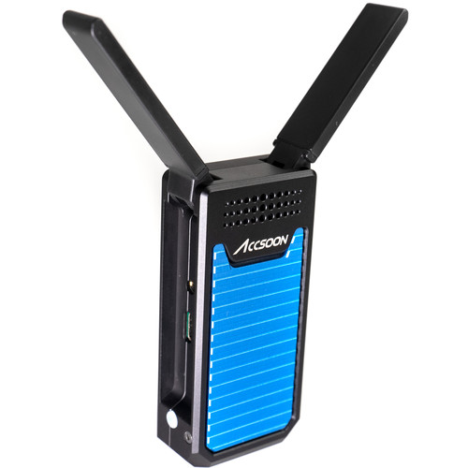
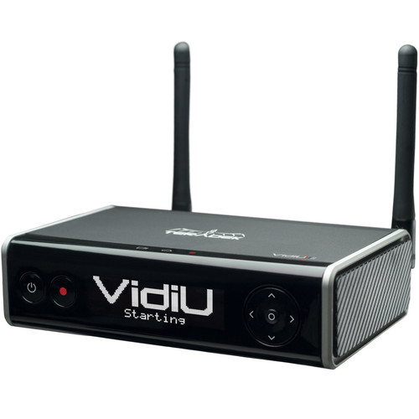
TERADEK VIDIU GO
ACCSOON CINEEYE AIR
Key Features
Video Quality: Up to 1080p60
Video Inputs: SDI and HDMI
2 x USB Ports, Ethernet, and Wi-Fi
Compression: AVC/H.264 and HEVC/H.265
Key Features
Use Your IOS/Android Devices as Monitors
Transmits up to 1080p Video, HDMI Input
Sends to up to 2 Devices Simultaneously
Up to 328' Transmission over 5 GHz Wi-Fi
Figure 5: Teradek Vidiu Go
Figure 6: Accsoon Cineye Air
https://bhpho.to/3hEQ4sF
https://bhpho.to/30UjOMn

Slide 6
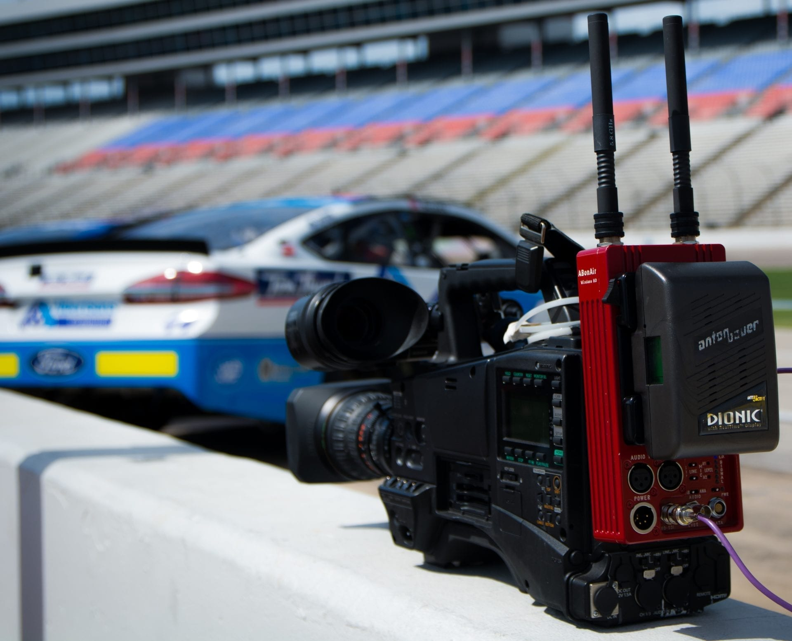
TRANSMISSION
TECHNOLOGIES
There are three leading wireless broadcast link technologies – each based on a different transmission method:
OFDM / COFDM solutions
Cellular network solutions
Video over WiFi solutions
Figure 7:A Broadcast Camera
https://www.abonair.com/blog/2019/02/10/wireless-broadcast-transmission-overview-2/

Slide 7
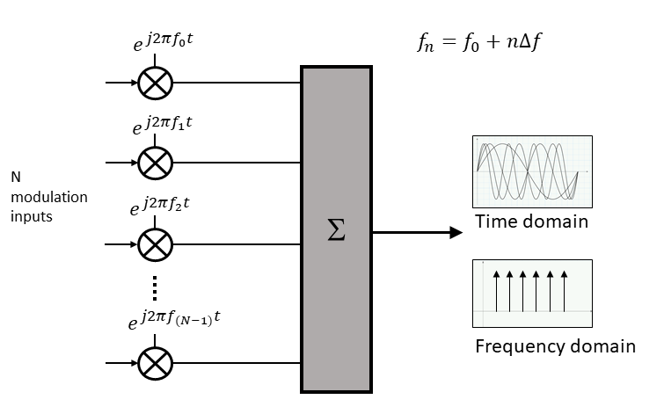
OFDM TECHNOLOGY
The transmitter is positioned on the camera; the receiver is located inside the OB-van or at the event’s media center where the content is gathered and transmitted forward.
Figure 8: Encoding Digital Data on multiple carrier frequencies.
https://www.5gtechnologyworld.com/the-basics-of-5gs-modulation-ofdm/

Slide 8
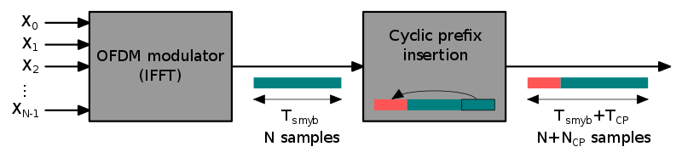
Figure 9:OFDM Cyclic Prefix Insertion
If million symbols per second are spread among one thousand sub-channels, the duration of each symbol can be longer by a factor of a thousand (i.e., one millisecond) for orthogonality with approximately the same bandwidth. Assume that a guard interval of 1/8 of the symbol length is inserted between each symbol. This corresponds to a maximum difference of 37.5 kilometers between the lengths of the paths.
https://en.wikipedia.org/wiki/Orthogonal_frequency-division_multiplexing

Slide 9
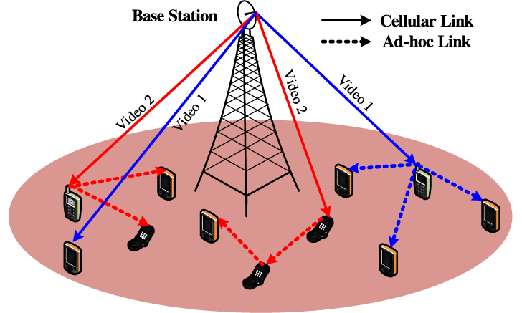
VIDEO LINKS OVER
CELLULAR NETWORKS
In wireless video links over cellular networks, the transmitter is positioned on the camera or in a backpack transmitting the content over the cellular network and broadcaster’s servers.
Figure 10: Video Dissemination over Hybrid Cellular and Ad Hoc Networks
https://bit.ly/2BiZLMY

Slide 10
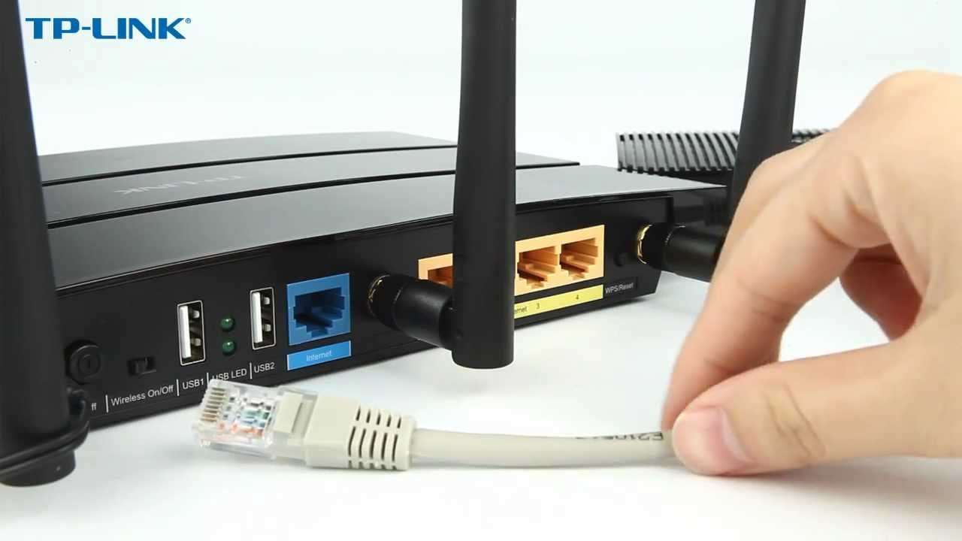
VIDEO LINKS OVER WIFI
In video over WiFi systems. The transmitter is located on the camera and the receiver is either near the WiFi access point in the same location or at the TV station beyond the internet cloud.
Figure 11: A TP-Link WiFi Router
https://bit.ly/2BhuABy

Slide 11
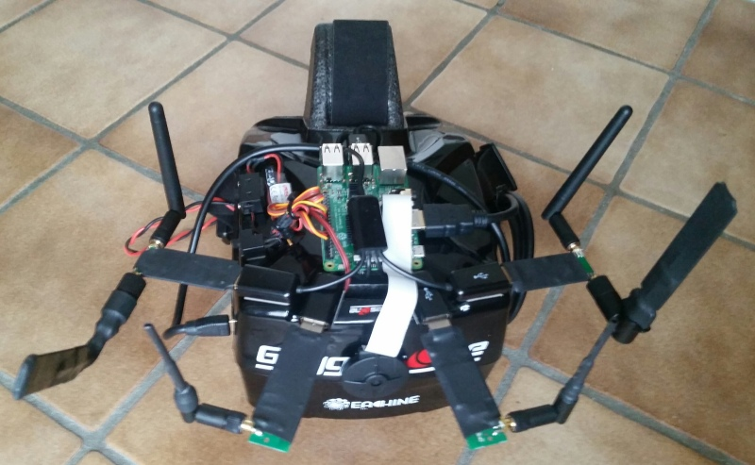
WIFIBROADCAST
Wifibroadcast is a project aimed at the live transmission of HD video data using WiFi radios. One prominent use case is to transmit camera images for a first person view (FPV) of remote controlled aircrafts.
Figure 12: EZ WiFi Broadcast
In contrast to a normal WiFi connection Wifibroadcast tries to mimic the advantageous properties of an analog link (like graceful signal degradation, unidirectional data flow, no association between devices).
https://bit.ly/3hChGip

Slide 12


